Slide 1

Facebook Live Sellers
Case project by : G Nanda Santosh

Slide 2
INDEX
Introduction
Data Preprocessing
Impact of Upload Time on Reactions
Correlation Analysis
K-Means Clustering
Post Types
Average Metrics by Post Type
Conclusion

Slide 3
Introduction:
The Facebook Live Sellers in Thailand dataset provides valuable insights into the engagement metrics of Thai fashion and cosmetics retail sellers on Facebook. By analyzing this data, we can uncover trends related to upload times, correlations between different metrics, and even group similar posts using clustering techniques.

Slide 4
Data Preprocessing:
Purpose:
Prepares the data for analysis with the help of required libraries in python (pandas, numpy, mathplotlib, seaborn, sklearn)
Explanation:
Handling Missing Values:
Addressed missing data by either dropping rows or imputing values.
Timestamp Conversion:
Converted the “status_published” column to datetime format for time-based analysis.
Hour Extraction:
Extracted the hour of upload from the timestamp.

Slide 5
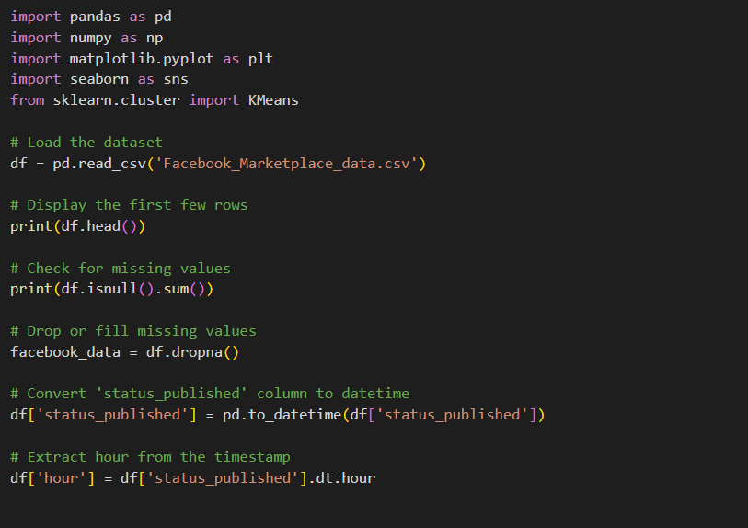
Code(python):

Slide 6
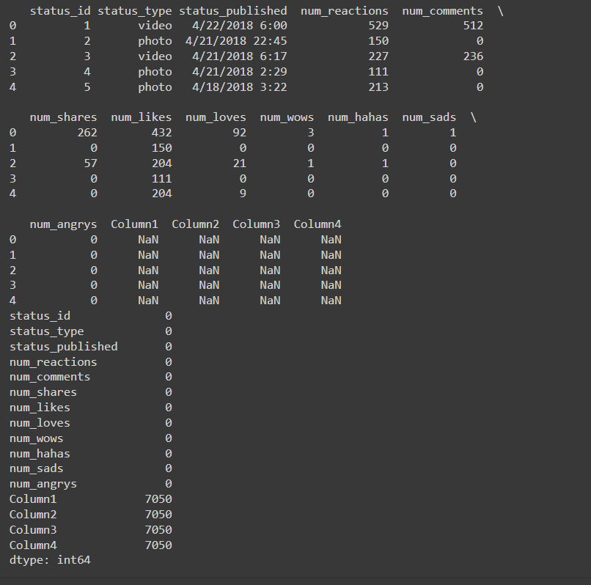
Output:

Slide 7
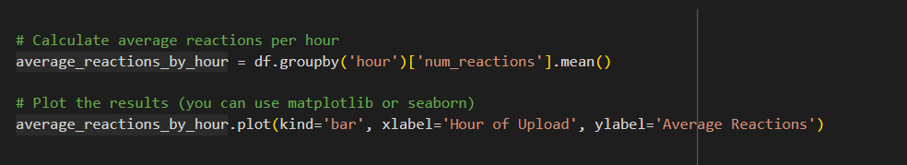
Impact of Upload Time on Reactions:
Purpose:
Investigate how upload time affects reactions
Explanation:
calculated the average reactions for each hour.
Code:

Slide 8
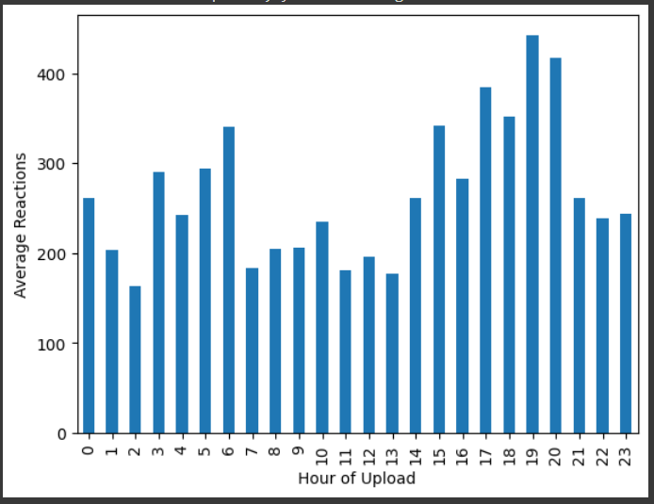
Result:

Slide 9
Correlation Analysis
Purpose:
Understand relationships between metrics.
Explanation:
We computed the correlation matrix for num_reactions, num_comments,
and num_shares.
The heatmap visually represents the strength and direction of correlations.

Slide 10
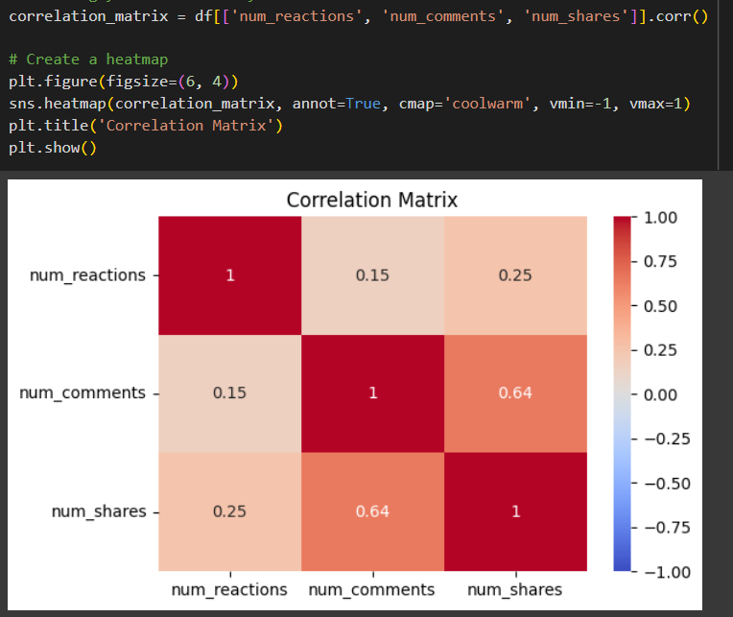
Code & Result:
.

Slide 11
K-Means Clustering
Purpose:
K-means helps us organize data into meaningful groups based on similarity, making it a fundamental technique in unsupervised learning.
Here,We group similar posts based on engagement metrics.
Explanation:
Used K-Means to cluster posts using features like reactions and comments.
The scatter plot shows how posts are grouped based on these metrics.
The WCSS (Within-Cluster Sum of Squares) in the Elbow Method helped to determine the optimal number of clusters.

Slide 12
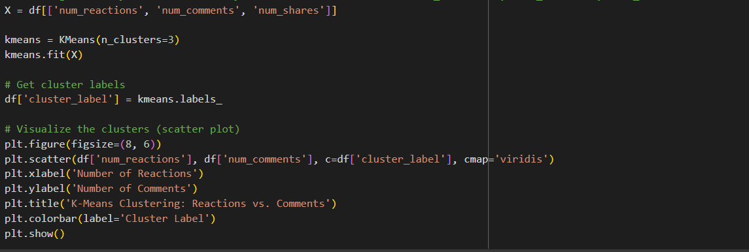
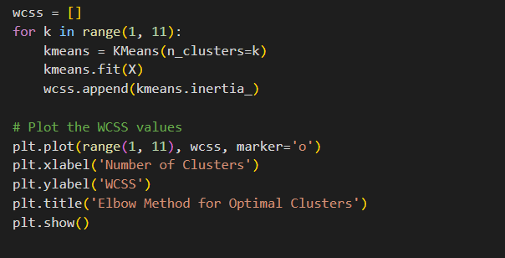
Code: (for 'K-Means Clustering: Reactions vs. Comments’)
Code: (for 'Elbow Method for Optimal Clusters’)

Slide 13
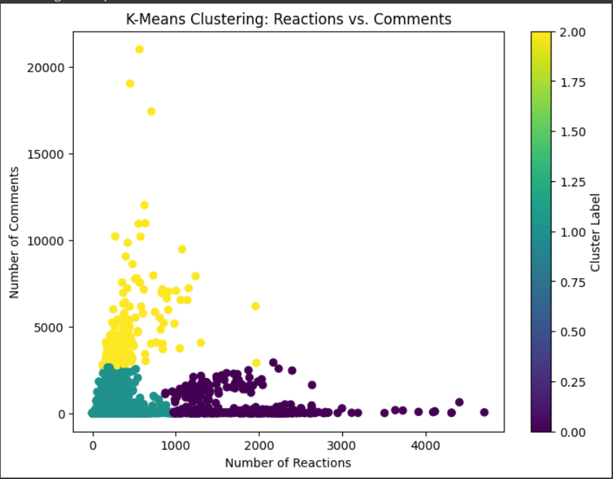
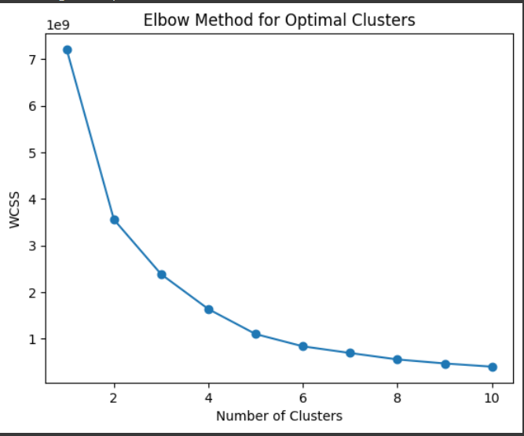
Result:

Slide 14
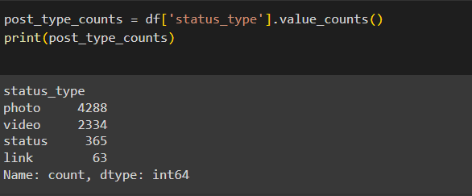
Post Types
Purpose:
Explores the distribution of post types.
Explanation:
Counted the occurrences of different post types (e.g., video, photo, status, link).
Code & Result:

Slide 15
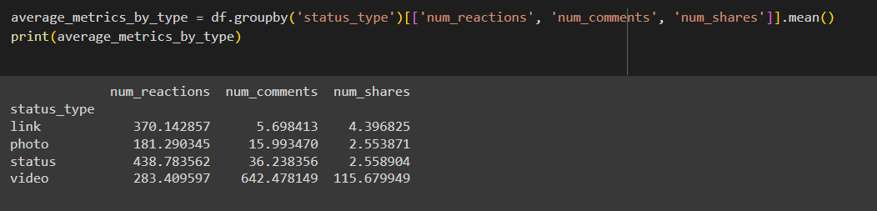
Average Metrics by Post Type
Purpose:
Compares engagement metrics across post types.
Explanation:
Calculated the mean values of reactions, comments, and shares for each post type. This helps identify which types of posts perform best.
Code & Result:

Slide 16
Conclusion:
In conclusion, our analysis of the Facebook Live Sellers in Thailand dataset revealed valuable insights:
Upload Time Impact: We observed trends in reactions based on the hour of upload. Sellers can optimize posting times for better engagement.
Correlations: The correlation analysis reveals that reactions and shares have a strong positive relationship, while comments also correlate positively with both reactions and shares with strength(0.64) and reactions and comments have a medium positive relationship with strength(0.15)
K-Means Clustering and elbow method: We grouped similar posts using K-Means. Sellers can tailor their approach based on these clusters and used wcss in elbow method to determine the optimal number of clusters.
Post Counts list: photo(4288),video(2334), status(365),link(63).
Recommendations: Sellers should consider upload timing, leverage correlations, and tailor content to post types for optimal results.

